Slide 1
EDUCATION
ASSIGNMENT

Slide 2
CONTENT
What did I learn?
Outcome
Screenshots

Slide 3
What did I learn?
I learned many things about Microsoft powerpoint.

Slide 4
Outcome
I learned how to use template, creating slide, animating the slide, inserting (charts,3d models , pictures),etc.

Slide 5
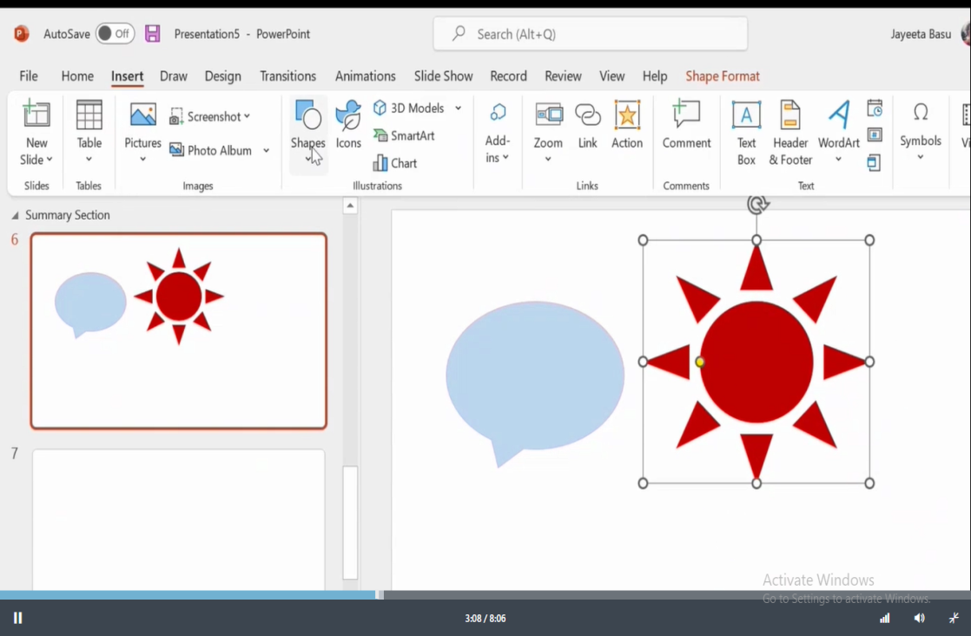
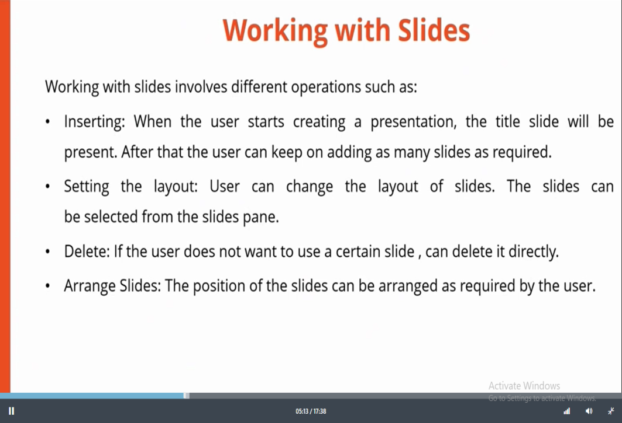
Screenshots

